Slide 1

AICTE IBM – EDUNET DATA ANALYTICS
Name : VENKATESH TIRUNAGARI
Skills Build Email ID : 21b65a0469@nmrec.edu.in
College Name : Nalla Malla Reddy Engineering College
College State : Telangana
Internship Domain : Data Analytics
Internship Start Date and End Date : 12-06-2023 to 24-07-2023
Notes:
Line spacing + Page numbers

Slide 2
PROJECT TITLE: Analysis of Superstore Dataset Problem Statement : To analyze the Superstore dataset to gain insights into sales trends, customer behavior, and operational efficiency. The dataset contains information about various aspects of stores operation ,including sales, orders, profits , discounts, shipping details , Product details Etc.

Slide 3
AGENDA :
Introduction
What is the Superstore dataset?
What are the goals of this project?
Data cleaning
How was the data cleaned?
Data analysis
What insights were gained from the analysis?
What are the implications for the Superstore?
Conclusion
Summary of the key findings
Recommendations for future action

Slide 4
The End Users :
•Store Managers: They require insights on sales performance, customer behavior, and operational efficiency to make informed decisions and optimize store operations.
•Marketing Managers: They need information on customer demographics, preferences, and buying patterns to develop targeted marketing campaigns and improve customer engagement.

Slide 5
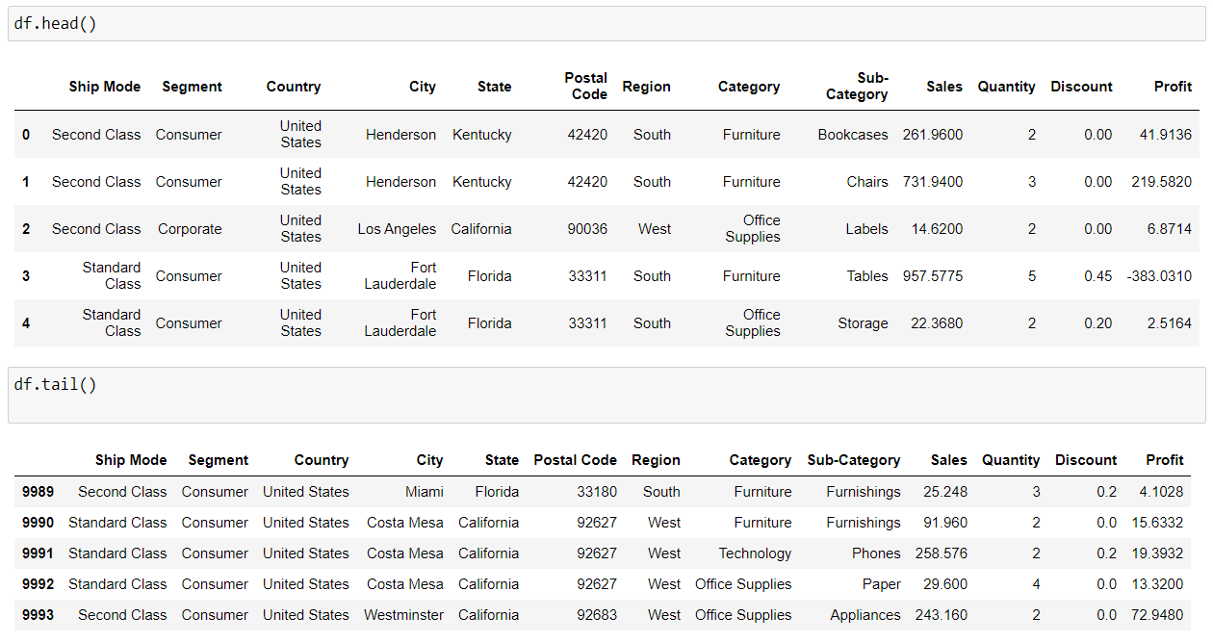
Introduction
01
The analysis on Superstore dataset is a comprehensive study that aims to analyze the sales performance of a fictional retail company called "Superstore".
Below Figure Shows the Dataset Provided by the Superstore:

Slide 6
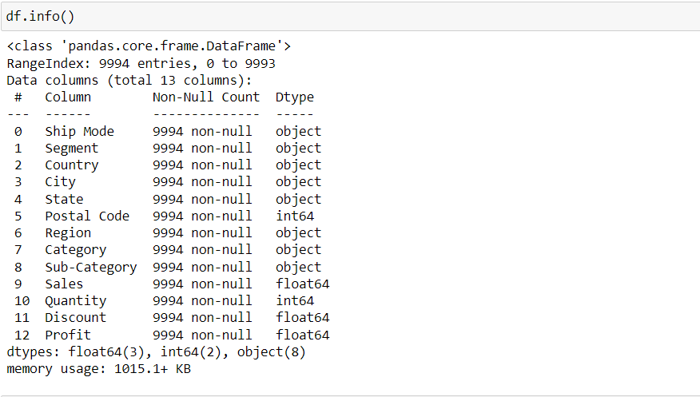
Data Cleaning
02
Identifying and removing duplicate records:
Identifying and correcting errors in data entry:
Standardizing data formats:
Dealing with missing values:
Dealing with missing values and Null values :

Slide 7

Analyzing Data and making Insights
03
Technologies Used :
Python is a general-purpose programming language that is increasingly being used for data science and machine learning. It is a powerful language that is easy to learn and use, and it has a large and active community of developers.
NumPy is a Python library that provides support for large, multi-dimensional arrays and matrices. It is a powerful tool for mathematical computing, and it is often used in conjunction with other Python libraries, such as Pandas and Matplotlib.
Pandas is a Python library that provides high-level data structures and data analysis tools. It is a powerful tool for data manipulation and analysis, and it is often used in conjunction with other Python libraries, such as NumPy and Matplotlib.
Matplotlib is a Python library that provides plotting and visualization capabilities. It is a powerful tool for creating data visualizations, and it is often used in conjunction with other Python libraries, such as NumPy and Pandas.

Slide 8
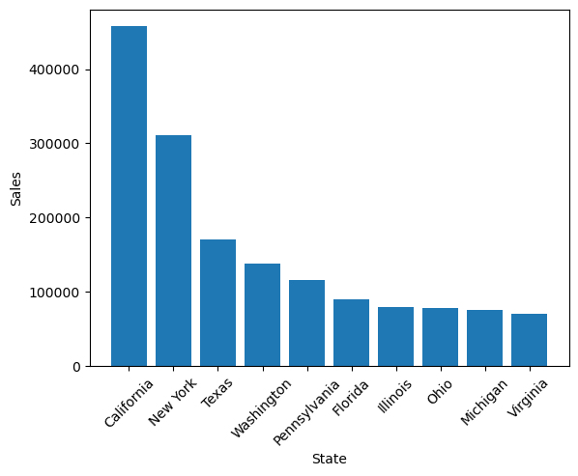
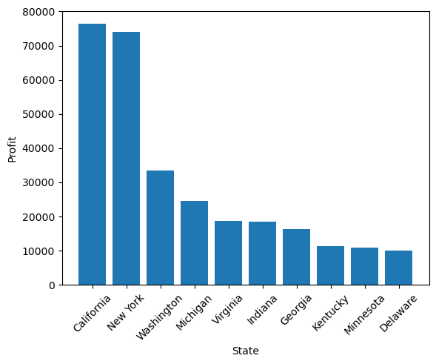
Finding the sales and Profits of Top 10 States

Slide 9
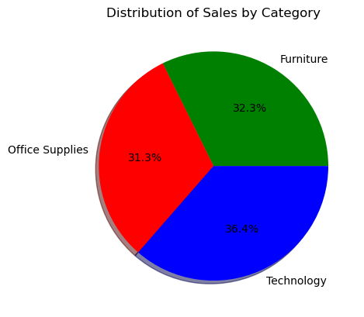
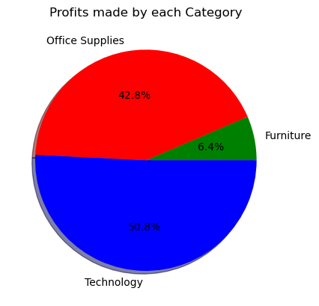
Finding the sales and Profits of Each Category

Slide 10
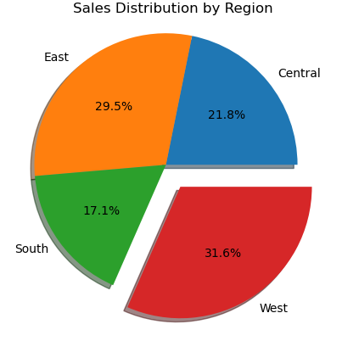
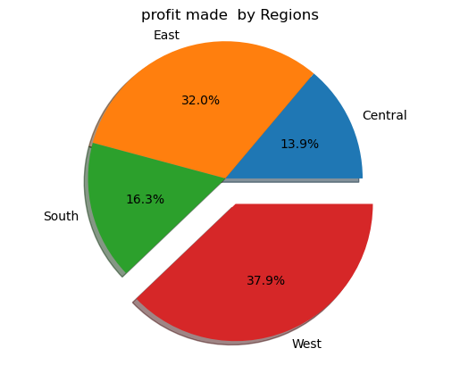
# Finding the Distribution of sales by Category # Finding the Profits Made by Each category
Finding the sales and Profits By Region

Slide 11
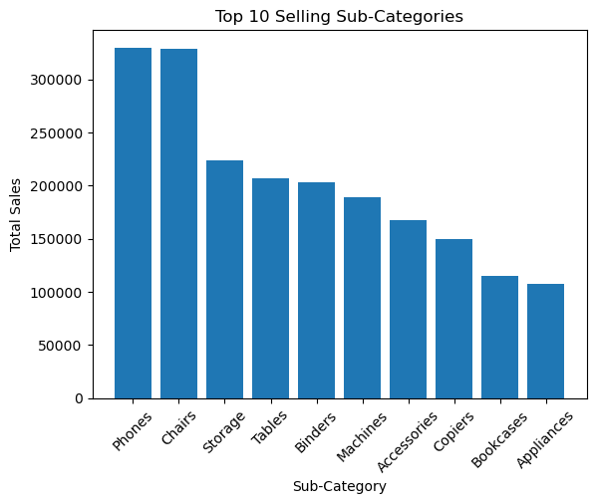
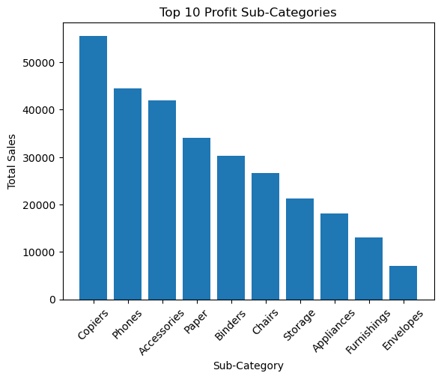
# Finding the Top 10 selling Sub-Category # Finding the TOP 10 Profits Made by sub-category
Finding the sales and Profits of Top 10 Sub-Catergory

Slide 12
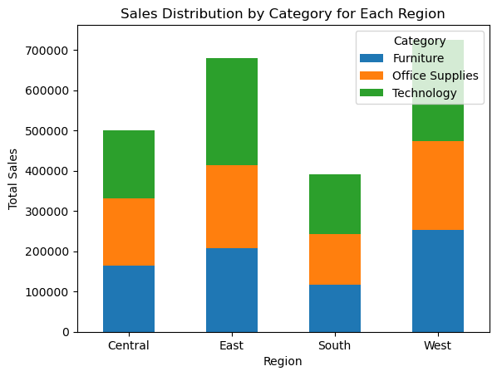
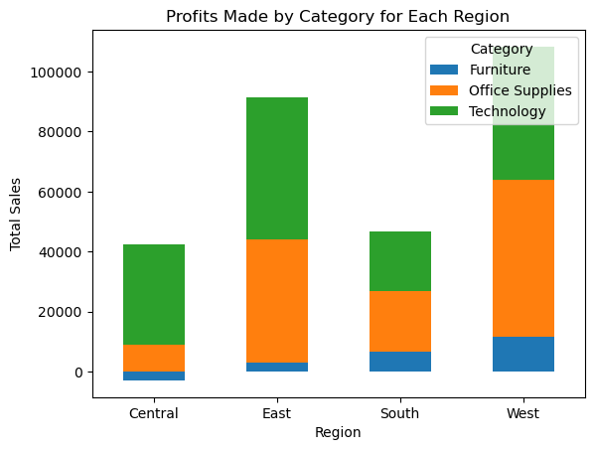
#Finding sales Distribution by category for each region #Finding Profits Made by category for each region
Finding the sales and Profits By Category For Each Region

Slide 13
Conclusion:
California, New York, Washington, and Michigan appear in both the top 10 sales and top 10 profit states, directing more resources and marketing efforts towards these states can lead to increased revenue and profitability.
While technology products generate the highest profit margin at 50.8%, office supplies have a respectable profit margin of 42.8% with a relatively higher sales percentage of 31.8%. To improve business performance, consider allocating more resources to promote and enhance the sales of technology products while also optimizing the product mix to focus on high-profit office supplies. This can help increase overall profitability and revenue.

Slide 14
Focus on West Region for Growth: The West region has the highest sales percentage at 31.6% and the highest profit margin at 37.9%. To drive business growth, consider allocating more resources and marketing efforts towards expanding operations in the West. Identifying the reasons behind the region's success and replicating successful strategies in other regions can lead to increased overall profitability and market share.
Emphasize High-Profit Subcategories: While both "phones" and "binders" appear in both the top 10 sales and top 10 profit subcategories, "phones" have higher profitability, being the second most profitable subcategory after "copiers." To improve business performance, focus on promoting and expanding the range of high-profit subcategories, such as "phones" and "accessories," as they have the potential to significantly boost overall profitability and contribute to the company's bottom line. Allocating resources to capitalize on these lucrative subcategories can result in better financial performance for the business.

Slide 15
Links:
GITHUB REPOSITORY: https://github.com/venky638/IBM-EDUNET-Data-Analytics
Sample Superstore Dataset : https://www.kaggle.com/datasets/bravehart101/sample-supermarket-dataset

